Slide 1
Tree-Based Models

Slide 2
Motivation
How does you make a decision?
Series of Yes/No questions (alternatively, True/False)
When you decide what you want for lunch – what kinds of questions do you ask yourself?
Am I hungry?
If yes, do I want to make something?
If yes, make a sandwich.
If no, buy food.
If no, don't eat.
Think of it like a (complicated) flow chart.
Source: https://disney.fandom.com/wiki/Variants/Gallery?file=Loki_Variants_promo_image.png
Think of it like alternate realities in the multiverse… from a single starting point, each choice you make creates branches that lead to different outcomes
Different decisions lead you to different variants of the same response
In "Loki," different decisions lead to different timelines, which lead to different Loki variants

Slide 3
Motivation
Can you think of situations where you've used a decision tree?
Volunteers – describe the situation. What decision were you making?
What questions did you ask yourself?
What were the possible outcomes?

Slide 4
Decision Trees

Slide 5
Decision Trees: Overview
Decision trees are non-parametric models (they're flexible!)
Can either output a numerical prediction (regression) or a categorical prediction (classification)
Classification and regression tree (CART)
Parent node
Child node 1
Terminal leaf node 1
Child node 2
Terminal leaf node 3
Terminal leaf node 2
Terminal leaf node 4
Root node (starting point)
Branch (sub-tree)
True
False
Final nodes of the tree, where predictions are made
Split

Slide 6
Decision Trees: Alternate View
When you create these trees, what is actually happening?
You have your response space (the entire area that includes all possible outputs from your data)
Region 1
Region 2
Region 3
Region 5
Region 6
Region 4
Entire response space, split into regions from the tree

Slide 7
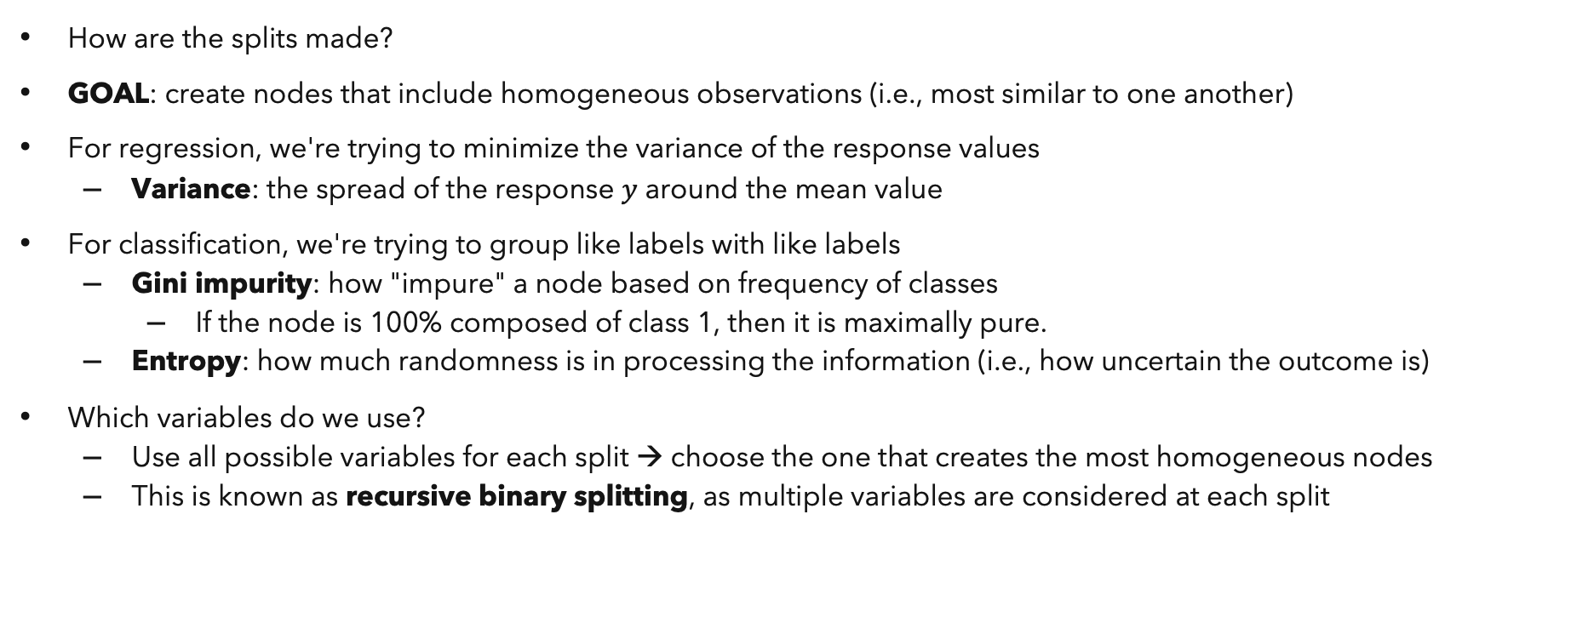
Decision Trees: Splitting
How are the splits made?
GOAL: create nodes that include homogeneous observations (i.e., most similar to one another)
For regression, we're trying to minimize the variance of the response values
Variance: the spread of the response $y$ around the mean value
For classification, we're trying to group like labels with like labels
Gini impurity: how "impure" a node based on frequency of classes
If the node is 100% composed of class 1, then it is maximally pure.
Entropy: how much randomness is in processing the information (i.e., how uncertain the outcome is)
Which variables do we use?
Use all possible variables for each split → choose the one that creates the most homogeneous nodes
This is known as recursive binary splitting, as multiple variables are considered at each split
Source: https://towardsdatascience.com/decision-trees-in-machine-learning-641b9c4e8052

Slide 8
Decision Trees: Advantages
Provides visual interpretation to the data
Handles a combination of numerical and categorical data
Defined rules are straightforward
Can more or less "dump and fit" data (requires little preprocessing)

Slide 9
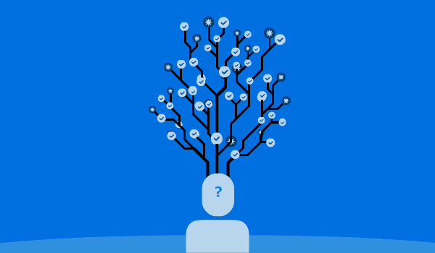
Decision Trees: Potential Problems?
You've built a tree – now what?
Your tree was built to have homogeneous nodes → what problem could this lead to?
POTENTIAL PROBLEM: your tree is very deep (many levels), which makes interpretability difficult
Solution: prune the tree, to help reduce the depth of the tree
Remove nodes that aren't that helpful
Reduces tree complexity
Solution: control the depth of the tree
POTENTIAL PROBLEM: your tree might predict well for the training data set
What happens if you introduce a testing data set?
Might not predict as well (your tree has overfit!)
Your tree low bias, but has high variance → how do we fix this?
Solution : combine trees to create an ensemble
Source: https://www.kdnuggets.com/2020/01/decision-tree-algorithm-explained.html

Slide 10
Decision Trees: Terminology
Term | Definition
Root node | Starting point of the tree, includes all data
Internal or intermediate node | Nodes that occur in the middle of the tree
Terminal node or leaf | Final nodes of the tree, where predictions are made This node is not split
Parent node | A node that is split to create two child nodes
Child node | The sub-node of a parent node
Branch or sub-tree | A subsection or part of a
Split | The process of dividing the parent node into two child nodes
Prune | Opposite of "split," where branches or child nodes are removed

Slide 11
Decision Trees: Versions
There are many ways to create decision trees, but they all follow the same general principle – create homogeneous nodes
CART
Classification and regression trees
Arguably the most popular algorithm
ID3
Iterative dichotomiser 3
Multiway tree (more than one split is possible for a single parent node)
C4.5
Converts continuous variables to a set of if-then rules
CHAID
Requires categorical variables
Chi-squared automatic interaction detection
Uses chi-squared statistics to choose best splits
Allows for both categorical and numerical variables

Slide 12
Decision Trees: Code
Import packages
from sklearn import datasets
from sklearn.ensemble import DecisionTreeClassifier, DecisionTreeRegressor
mnist = datasets.load_digits()
X = mnist.data
Y = mnist.target
clf = DecisionTreeClassifier(criterion = 'gini', max_depth = None)
clf.fit(X_train, y_train)
y_pred = clf.predict(X_test)
Load data
How splits are determined
How deep trees are grown
Fit the model
Make predictions

Slide 13
Decision Trees: Code
from sklearn.tree import plot_tree
plt.figure(figsize = (30, 10))
plot_tree(dt_clf, feature_names = X.columns, class_names = [str(i) for i in y.cat.categories], filled = True)
plt.show()

Slide 14
Try fitting a decision tree yourself!
First… let's play around with the MNIST data set.

Slide 15
Random Forest (RF)

Slide 16
Random Forest: Overview
Combine trees (weak learners) to create a forest (an ensemble of weak learners)
"Random"
Create different samples of training data for each tree (row sampling)
Use random subsets of predictors for each split (column sampling)
"Forest"
Many decision trees

Slide 17
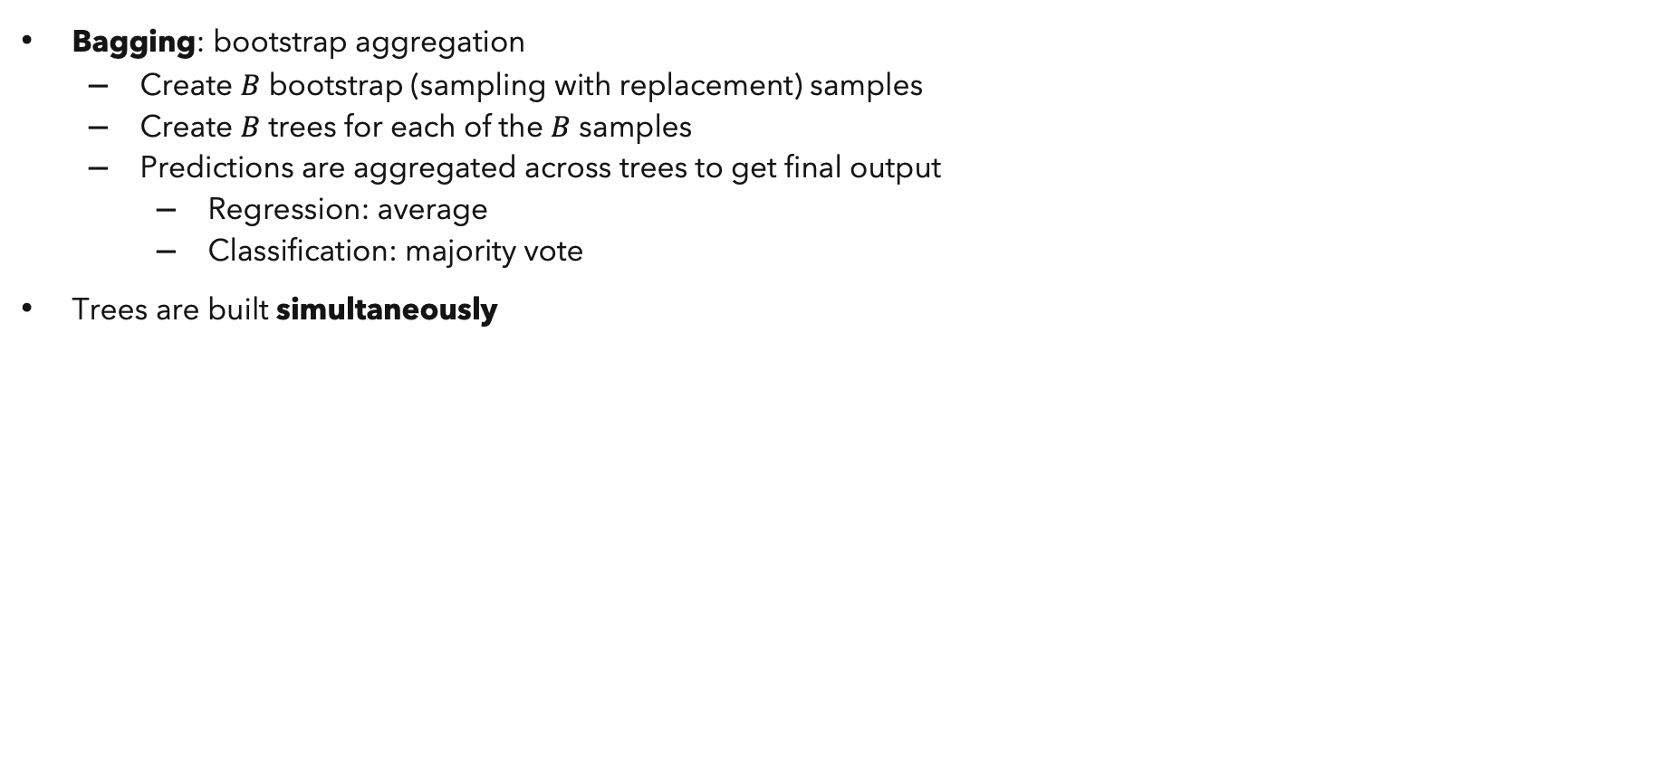
Random Forest: Algorithm
Bagging: bootstrap aggregation
Create $B$ bootstrap (sampling with replacement) samples
Create $B$ trees for each of the $B$ samples
Predictions are aggregated across trees to get final output
Regression: average
Classification: majority vote
Trees are built simultaneously
Tree 1
Tree 2
...
Tree $B$
Tree 𝐵
Original data
Bootstrapping
Aggregating
Ensemble of trees

Slide 18
Random Forest: Pros and Cons
Pros
Model is less likely to overfit
Averages across multiple trees
Uses subsets of all variables, so the trees are uncorrelated (not associated) with another
Easy to use – it's a combination of decision trees
Inherently provides variable importance (which features contribute most to the predictions)
Not all variables are used at every split, so the impact of leaving a variable out is easily obtained
Cons
Since so many decision trees are fit, need a lot of memory and computation resources – problems when the data is large
Can be difficult to interpret – what does an average of many decision trees mean?

Slide 19
Random Forest: Code
Import packages
from sklearn import datasets
from sklearn.ensemble import RandomForestClassifier, RandomForestRegressor
mnist = datasets.load_digits()
X = mnist.data
Y = mnist.target
clf = RandomForestClassifier(n_estimators = 100, criterion = 'gini', max_depth = None, max_features = 'sqrt')
clf.fit(X_train, y_train)
y_pred = clf.predict(X_test)
Load data
How splits are determined
How deep trees are grown
Number of trees
Fit the model
Size of feature subset used at each split
Make predictions

Slide 20
Random Forest: Code
from sklearn.tree
import plot_tree plt.figure(figsize = (30, 10))
plot_tree(clf.estimators_[1], feature_names = , filled = True)
Plot one of the trees in the forest

Slide 21
Random Forest: Code
from sklearn.metrics import accuracy_score
print("Accuracy: ", accuracy_score(y_test, y_pred))
feature_imp = pd.Series(clf.feature_importances_).sort_values(ascending = False)
Import packages
Output accuracy
Variable importance of the variables

Slide 22
Try fitting a random forest yourself!

Slide 23
Gradient Boosting Machines (GBMs)

Slide 24
Gradient Boosting Machines: Intuition
A golfer has a general idea of where the hole is
They'll give the golf ball a whack, and (generally) it will land somewhere closer to the hole
Each subsequent hit, the golfer will get closer and closer to the hole
Each hit gives the golfer a chance to reassess how close they are to the hole (distance) and which direction they need to go
Some hits may overshoot the hole, but subsequent hits will slowly get closer to the goal
Source: https://explained.ai/gradient-boosting/L2-loss.html#sec:2.3

Slide 25
Gradient Boosting Machines: Overview
Combine trees (weak learners) to create a sequential machine (an ensemble of weak learners)
Instead of fitting trees simultaneously, we fit trees sequentially, improving model fit with every iteration
"Gradient"
With each model, we assign difficult observations higher weights to improve prediction performance
Each sequential model learns from the mistakes of the previous model
These errors are also known as residuals
"Boosting"
The above idea is known as "boosting"
We boost the signal of the most wrong observations
"Machines"
Final prediction is a weighted sum of all "machines" in the model

Slide 26
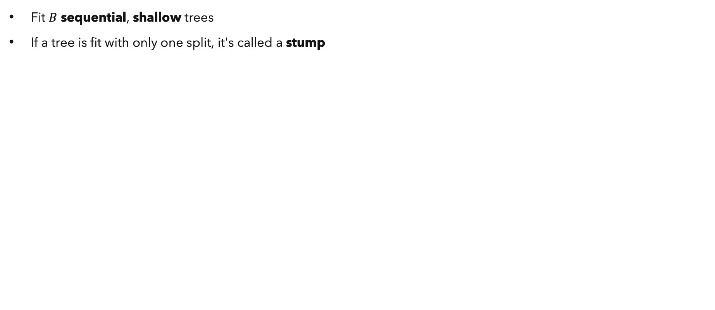
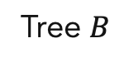
Gradient Boosting Machines: Algorithm
Fit $B$ sequential, shallow trees
If a tree is fit with only one split, it's called a stump
...
Final predictions
Tree 1
Tree 2
Original data
Tree $B$
Tree 3

Slide 27
Gradient Boosting Machines: Versions
Unlike the Random Forest, there are many ways to implement GBMs
Key differences in methods are in the algorithm (efficiency)
Popular methods:
Gradient boosting machine (GBM) – originally introduced in 2001 by J.H. Friedman
XGBoost (XGB) – introduced in 2014 by T. Chen and C. Guestrin
LightGBM – introduced by 2016 by G. Ke
Catboost – introduced in 2017 by A. Gulin
Reported as 10x faster than XGB
Added regularization to avoid overfitting by minimizing the complexity of the model
Grows symmetric trees

Slide 28
Gradient Boosting Machines: Code
Import packages
from sklearn import datasets
from sklearn.ensemble import GradientBoostingClassifier, GradientBoostingRegressor
mnist = datasets.load_digits()
X = mnist.data
Y = mnist.target
clf = GradientBoostingClassifier(n_estimators = 100, criterion = 'squared_error', max_depth = 3, max_features = None)
clf.fit(X_train, y_train)
y_pred = clf.predict(X_test)
Load data
How splits are determined
Number of trees
Fit the model
Size of feature subset used at each split
How deep trees are grown
Make predictions

Slide 29
Try fitting a gradient boosting machine yourself!

Slide 30
Discussion:
Which tree-based method is the "best" in your opinion?
Why?

